Slide 1
Writing a Film Essay
Practice Exam Preparation
Wednesday
Notes:
This template can be used as a starter file to give updates for project milestones.
Sections
Sections can help to organize your slides or facilitate collaboration between multiple authors. On the Home tab, under Slides, click Section, and then click Add Section.
Notes
Use the Notes pane for delivery notes or to provide additional details for the audience. You can see these notes in Presenter View during your presentation.
Keep in mind the font size (important for accessibility, visibility, videotaping, and online production)
Coordinated colors
Pay particular attention to the graphs, charts, and text boxes.
Consider that attendees will print in black and white or grayscale. Run a test print to make sure your colors work when printed in pure black and white and grayscale.
Graphics, tables, and graphs
Keep it simple: If possible, use consistent, non-distracting styles and colors.
Label all graphs and tables.

Slide 2
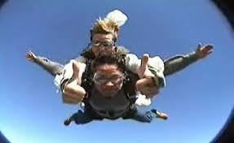
We Know How To…
Describe scenes from the film
Describe film shots and other techniques
Structure our essay into paragraphs and use the SEED methodology within each of the paragraphs
Notes:
What is the project about?
Define the goal of this project
Is it similar to projects in the past or is it a new effort?
Define the scope of this project
Is it an independent project or is it related to other projects?
* Note that this slide is not necessary for weekly status meetings

Slide 3
5 Essay Components
Essay
Introduction
Paragraph 2
Paragraph 3
Conclusion
Paragraph 1
Notes:
What are the dependencies that affect the timeline, cost, and output of this project?

Slide 4
We Know A Detailed Essay to Write if we get a question on bullying or on setting
Practice lessons and writing last week.
But What if We Get a Different Question and not the one we’ve been practising?
Notes:
* If any of these issues caused a schedule delay or need to be discussed further, include details in next slide.

Slide 5
Issues and Resolutions
Description of the issue
How was it resolved?
What and how did it impact the project?
Time
Cost
Other
Notes:
Duplicate this slide as necessary if there is more than one issue.
This and related slides can be moved to the appendix or hidden if necessary.

Slide 6
Film Essay Planner
Part 1 of question (In this box, name the theme that you will write about) | In this box, list at least 3 film techniques which helped to highlight this for you. | This row will help you write your introductory paragraph.
Scene 1 In this box, name a scene that shows this | Name the film techniques from this scene. | This row will help you write your 2nd paragraph.
Scene 2 In this box, name a scene that shows this | Name the film techniques from this scene. | This row will help you write your 3rd paragraph.
Scene 3 In this box, name a scene that shows this | Name the film techniques from this scene. | This row will help you write your 4th paragraph.

Slide 7
Checklist
Milestone 1
Milestone 2
Milestone 3
Answered Part 1 of question
Included film techniques
Milestone 4
Use DEVELOPMENT to answer 2nd part of the question
Structured most of the essay
Notes:
The following slides show several examples of timelines using SmartArt graphics.
Include a timeline for the project, clearly marking milestones, important dates, and highlight where the project is now.

Slide 8
Check Back Over Your Work
Part 1
of question
Film Techniques
Essay Structure
Part 2
of question

Slide 9
Draw Out A Planner In Your Books
Part 1 of question (In this box, name the theme that you will write about) | In this box, list at least 3 film techniques which helped to highlight this for you. | This row will help you write your introductory paragraph.
Scene 1 In this box, name a scene that shows this | Name the film techniques from this scene. | This row will help you write your 2nd paragraph.
Scene 2 In this box, name a scene that shows this | Name the film techniques from this scene. | This row will help you write your 3rd paragraph.
Scene 3 In this box, name a scene that shows this | Name the film techniques from this scene. | This row will help you write your 4th paragraph.

Slide 10
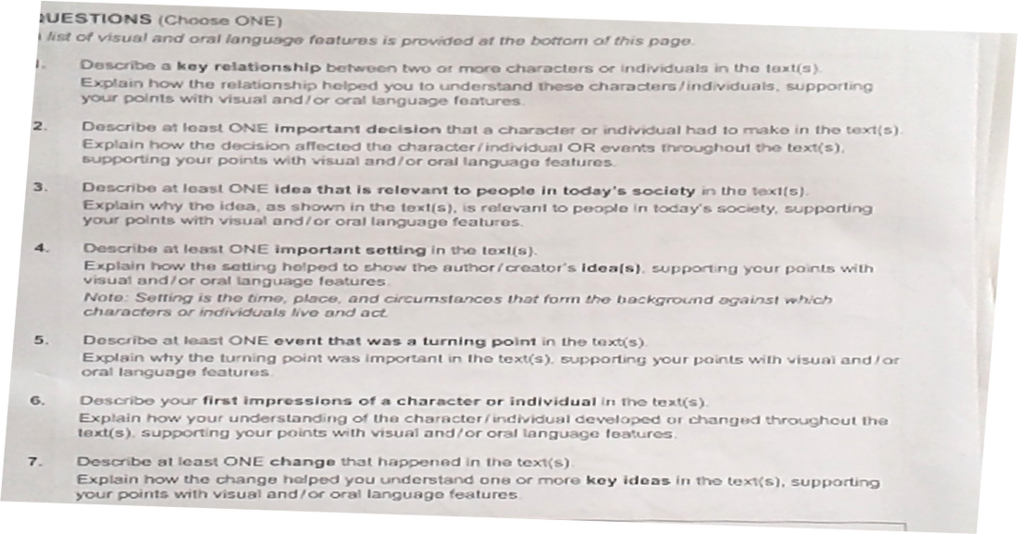
Choose a Question and Fill in The Gaps in Planner
Notice 2 PARTS to the QUESTION. Only one part is put in bold writing.

Slide 11
Good Luck!
Failure is not an option!
Notes:
Prepare slides for the appendix in the event that more details or supplemental slides are needed. The appendix is also useful if the presentation is distributed later.

