Slide 2
Mise en Scene uses symbolism to convey meaning
S – setting, props
C – costume, hair, make-up
A – acting, facial expression
L –lighting, colour
P – positioning of actors on
screen

Slide 3
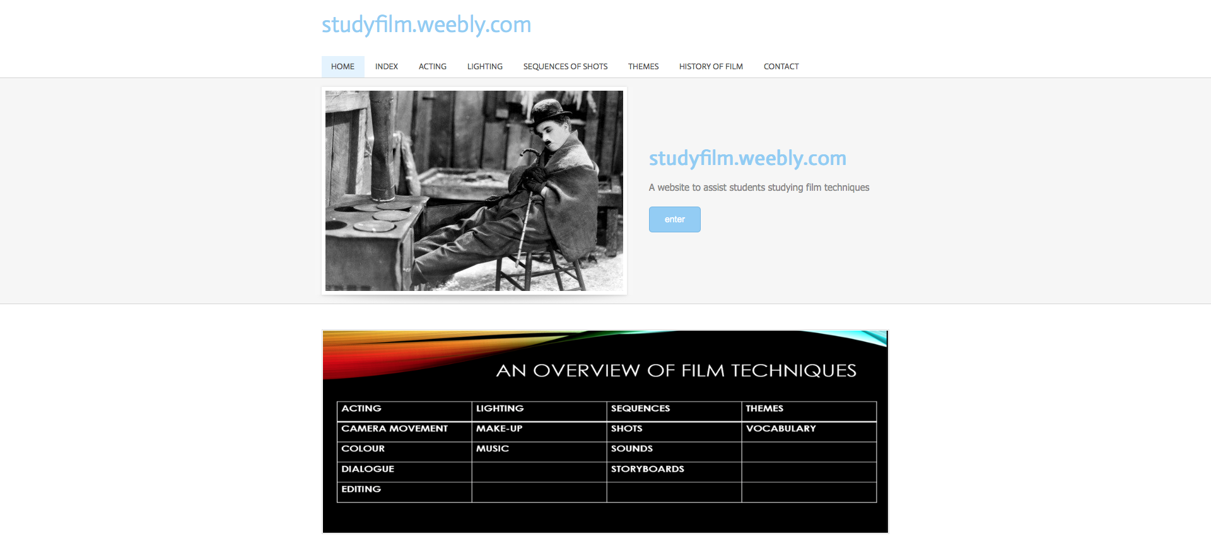
www.studyfilm.weebly.com
http://www.appsgeyser.com/getwidget/Symbolquiz

